Slide 1
2. Handling Form Submission
Roy Chancellor

Slide 2
Overview
Simple web service that creates a form and displays the results of submitting the form using HTTP GET and POST requests
Download project from https://github.com/roychancellor/SpringDemos.git
Instructions for running are in Application.java
Once server is running, navigate to http://localhost:8080/greeting to see the form, enter an id number and a message, then click Submit or Reset. Clicking submit will show the form data; clicking Reset will reset the form to default.

Slide 3
Project Structure
Application.java: contains main() which Spring finds and runs the SpringApplication.run method
GreetingController.java: receives and responds to HTTP GET and POST requests
Greeting.java: a POJO with two data fields and two getters/setters
pom.xml: contains all of the Maven dependencies
Spring deploys the application in its own Tomcat server
Comments in the .java files explain how everything works

Slide 4
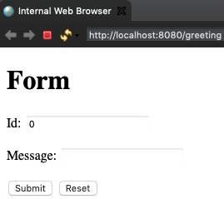
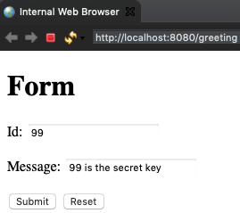
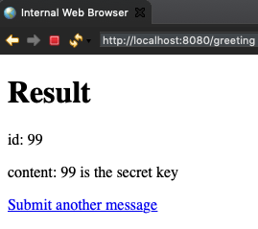
Screen Shots:

